Slide 1





Διαγνωστική προσέγγιση: NGS για όλους;
Prof. Alexandros Spyridonidis, MD, PhD
Head
Bone Marrow Transplantation Unit, www.bmtpatra.gr
Institute of Cell Therapy, www.ictpatras.gr
CBMDP Donor Center, www.xarisezoi.gr
MSc Cell and Gene Therapies, www.mastercgt.com
University of Patras
ΕΒΜΤ, Leader RIC Committee of Acute Leukemia WP
JACIE Inspector CGT-GMP

Slide 2
COIs
Disclosures (last and current year)
advisory board membership | Gilead, MSD, Novartis
travel support | Amgen, Gilead, MSD, Menarini
honoraria | Amgen, MSD, Bristol, Genesis, Gilead
consultancy | Abbvie, Novartis, Prime View
research support | Takeda, Abbvie
Disclaimers for this presentation
honoraria | Genesis Pharma S.A

Slide 3
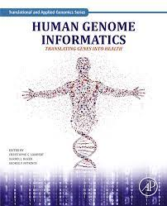

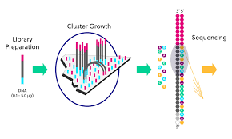

NGS - massively parallel sequencing
Sanger sequencing:
1st generation slow and laborious
>100 million USD in 2001
NGS:
millions of small fragments of DNA are sequenced simultaneously
< 10.000 USD in 2015
Illumina
Thermo Fisher Scientific
Pacific Bioscience
Oxford Nanopore Technology
SmidgION
‘(ultra) deep sequencing’
NGS approaches enabling the detection of rare clonal cells comprising 1% or less of the original sample

Slide 4
NGS applications
Whole genome sequencing (entire genome ‐ ~3B base pairs)
Whole exome sequencing (~30M base pairs)
Sequencing limited to protein coding regions representing ~1% of genome (Mutation panels)

Slide 5
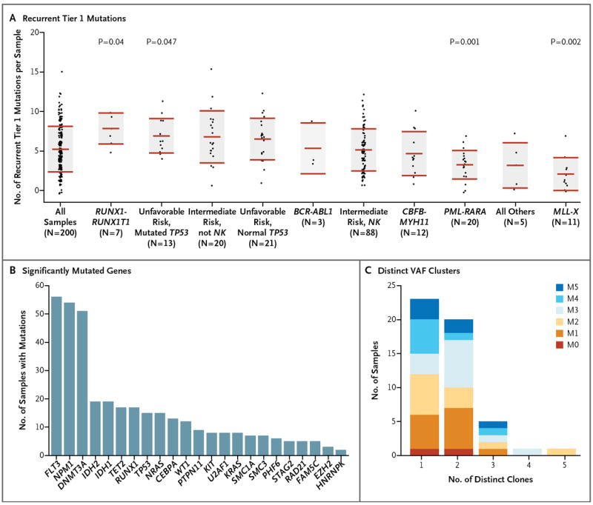
Clinically important information is derived from large scale genetic analysis by WG- NGS:
Cancer Genome Atlas Research Network
(whole genome (50) or whole exome (150) sequencing)

Slide 6
NGS → New diagnostic and prognostic classification
(WHO 2016 and ELN 2017)

Slide 7
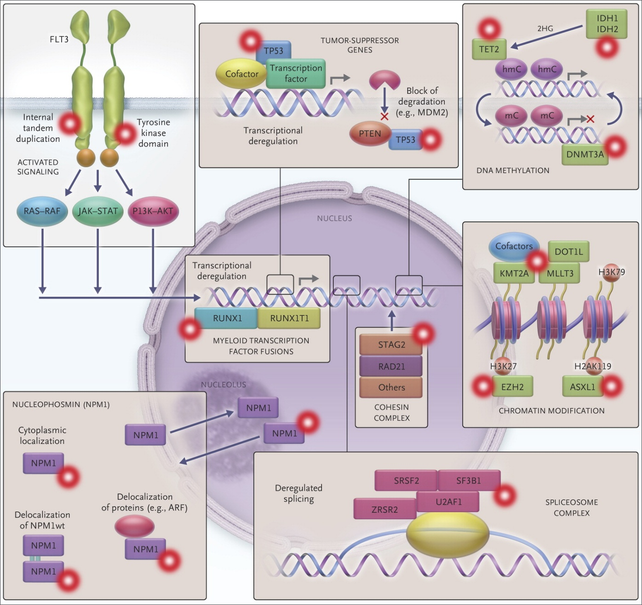
NGS → AML Pathogenesis
Eight functional categories of genes commonly mutated in AML
DAT mutations → CHIP

Slide 8
NGS targeted myeloid panels in every day clinical practice
30 Genes: Evangelismos Myeloid panel (Sophia Genetics)
Hotspot genes: ABL1(4-9), ASXL1(9,11,12), BRAF(15), CALR(9), CBL(8,9), FLT3(13-15,20), HRAS(2-3),IDH1(4), IDH2(4), KIT(2,8-11,13, 17,18), KRAS(2,3), MPL(10), NPM1(10,11), NRAS(2,3),PTPN11(3,7-13), SETBP1(4), SF3B1(10-16), SRSF2(1), U2AF1(2,6), WT1(6-10)
Full genes: CEBPA, CSF3R, DNMT3A, ETV6, EZH2, JAK2, RUNX1, TET2, TP53, ZRSR2, CNVs
38 Genes
37 Genes

Slide 9
Targeted myeloid panel NGS : market expands!

Slide 10
NGS→ New GENETIC classification and stratification of AML
The 5th edition of the World Health Organization Classification of Haematolymphoid Tumours: Myeloid and Histiocytic/ Dendritic Neoplasms. Leukemia (2022) 36:1703–1719; (Published online: 22 June 2022)
International Consensus Classification of Myeloid Neoplasms and Acute Leukemias: integrating morphologic, clinical, and genomic data. Blood 15 SEPTEMBER 2022 | VOLUME 140, NUMBER 11 (prepublished online on Blood First Edition 29 June 2022.)
Diagnosis and management of AML in adults: 2022 recommendations from an international expert panel on behalf of the ELN. Blood 22 SEPTEMBER 2022 | VOLUME 140, NUMBER 12, DOI 10.1182/blood.2022016867. (prepublished online on Blood First Edition 7 July 2022)

Slide 11
Do we need a comprehensive genetic characterization with Targeted NGS for AML?
Expensive, may not be reimbursed by payers
Time consuming
Variants of unknown significance – what to do?
Some of the information is not currently actionable

Slide 12
Yes if this is translated into clinical valuable information
NGS for everybody?

Slide 13
NGS for (accurate)diagnosis

Slide 14
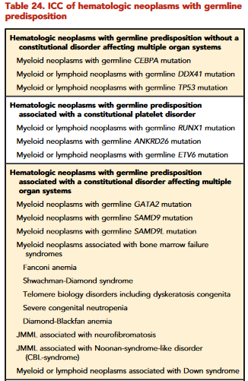
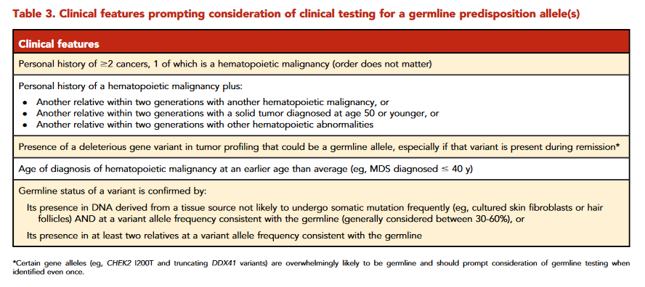
AML with germline predisposition

Slide 15
Case scenario- I
Female 34 years
Κύηση αναιμία → τοκετός → αναιμία Hb 6.9g/dl) →ΜΔΣ
ΟΜΒ δυσερυθροποίησης, χωρίς σιδηροβλάστες, 2% βλαστες, χωρίς σιδηροβλάστες, Ca ούρων κφ
Ν. Ευαγγελισμός, Κ
Μαρία Γαροφαλάκη
https://www.ncbi.nlm.nih.gov/clinvar/
https://spliceailookup.broadinstitute.org
https://gnomad.broadinstitute.org/

Slide 16
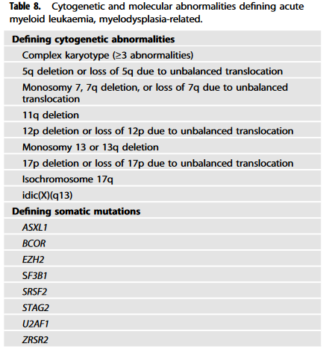
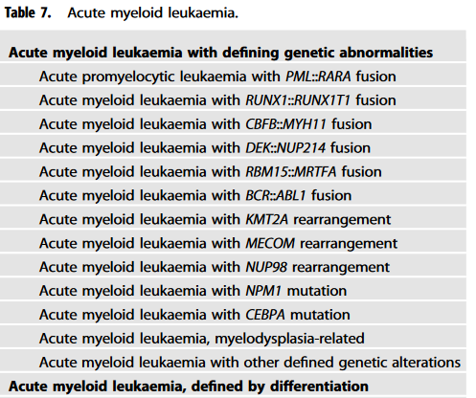
5th WHO → “Genetic” AML diagnosis
Most AML with defining genetic abnormalities may be diagnosed with <20% blasts.
AML with defining genetic abnormalities
AML defined by differentiation.
AML, NOS is no longer applicable
AML transformation of MDS and MDS/MPN continues to be defined under AML-MR in view of the broader unifying biologic features

Slide 17
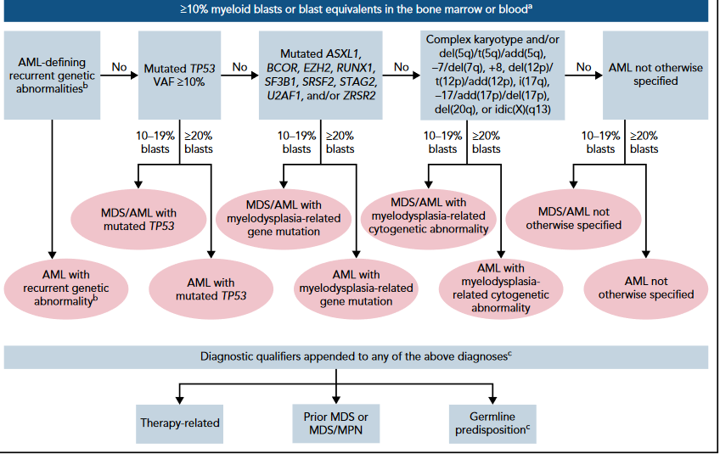
ICC (and ELN) for diagnosis

Slide 18
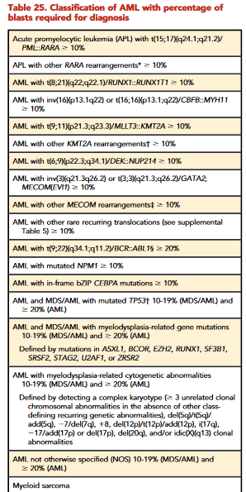
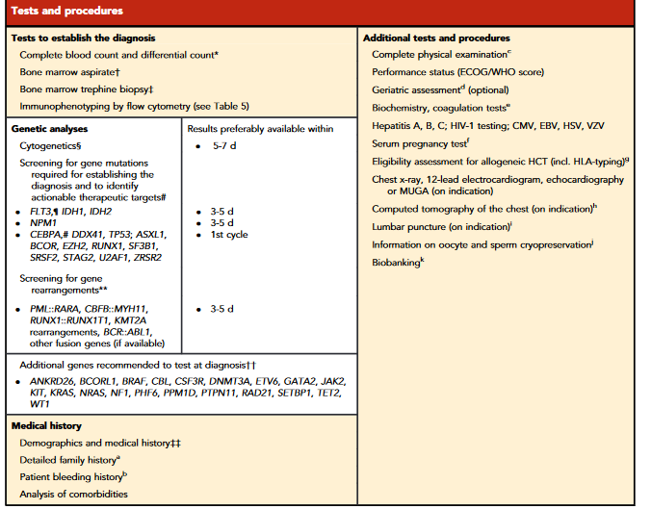
NGS for diagnosis for a patient with AML
fast NGS testing for clinically relevant biomarkers needed

Slide 19
Case scenario- II
Male 54 years
4/2021 MDS, IPSSR Low Risk
WBC: 3500/mmc, Hb: 11,9 gr/dl, PLT: 198.000/mmc
FACS-ΒΜ: βλαστικά κύτταρα 2%
Καρυότυπος-BΜ: 46,XY, FISH : p53 negativ
NGS-BM : U2AF1
7/22 MDS/AML βλάστες 17%
6/9/2022 VUD PBSC μεταμόσχευση
Molecular International Prognostic Scoring System for Myelodysplastic Syndromes, NEJM Evidence June 2022

Slide 20
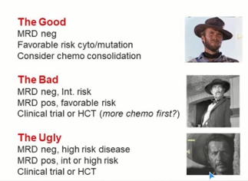
NGS for therapy decision (prognostic stratification)

Slide 21
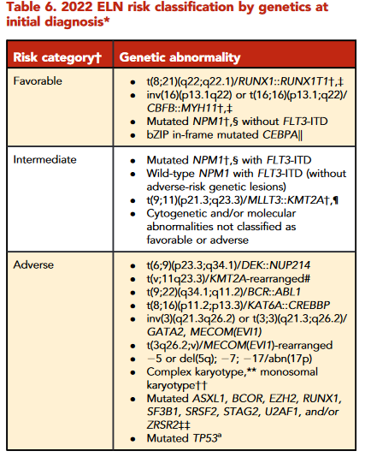
For prognostic stratification

Slide 22
NGS for identification of druggable targets

Slide 23
Targeted therapy in frontline therapy: how precisely can we treat AML
FLT3 mutation
CT +midostaurin
Quizartinib, gilteritinib, crenolanib (under investigation)
IDH1/2 mutation
CT±ivosidenib/enasidenib (HOVON 150/AMLSG 29-18 trial)
In chemotherapy-ineligible pts.: ivosidenib+azacytidine (IDH1m), venetoclax+HMAs (IDH1/2m)
TP53m
Prioritize clinical trials: eprenetapopt (APR-246), magrolimab
Other subtypes/targets
NPM1m AML: SYKi (entospletinib),……
KMT2A-r/PTD
NPM1m AML
Menin-inhibitor (JNJ-75276617, KO-539)
Other targets
CELMOD (CC-90009,CC-91633)
MDM2i (HDM201, idasanutlin,…)
BET bromodomain inhibitors
SYKi (entospletinib,…)

Slide 24
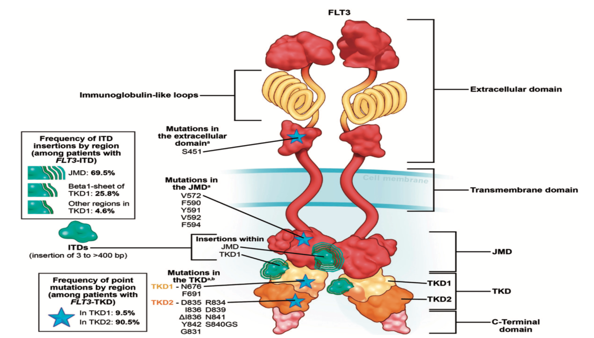
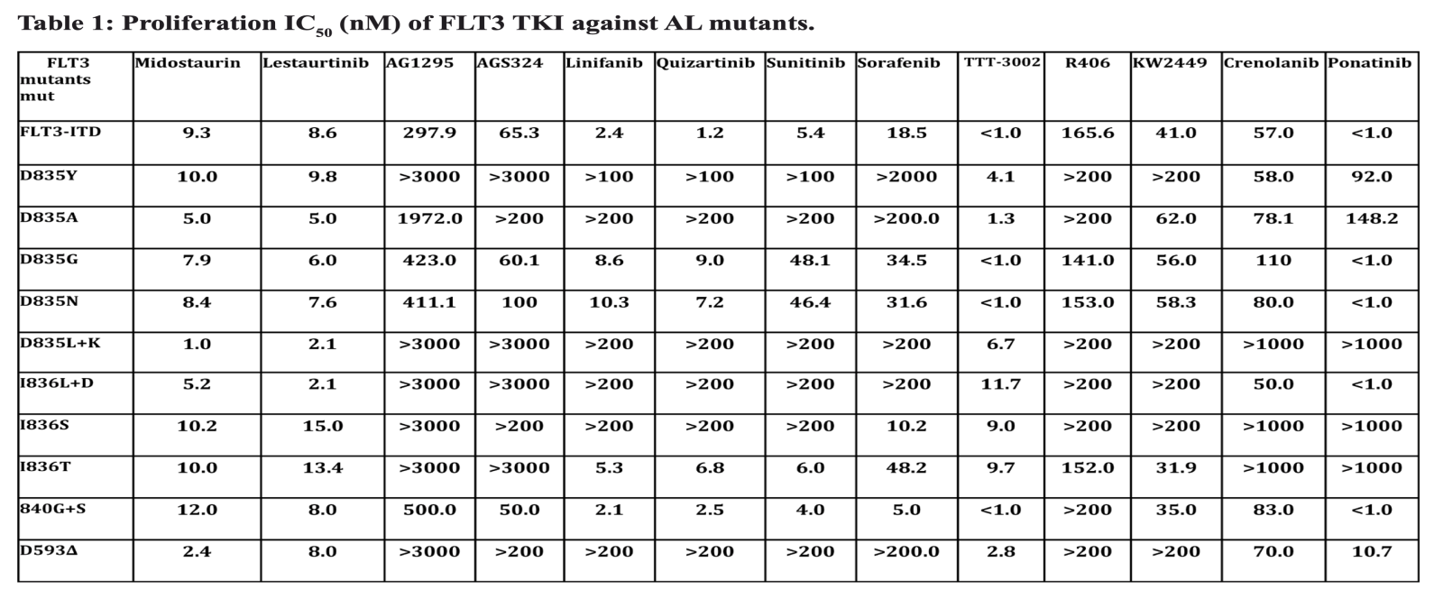
FLT3 rare variants: point mutations at JMD, FLT3i-resistant mutation at TKD1 (e.g., N676), rare variants at TKD2,…
Prognostic impact & response to FLT3 inhibitors?
Heidel F, et al. Blood 2006;107:1761-9
Opatz S, et al. Blood 2013;122:293-300
Pauwels D, et al. Haematologica 2012;97:1773-4
Spiekermann K et al. Blood 2002;100:3423-5
Nguyen B, et al. Oncotarget 2017;10931-44

Slide 25
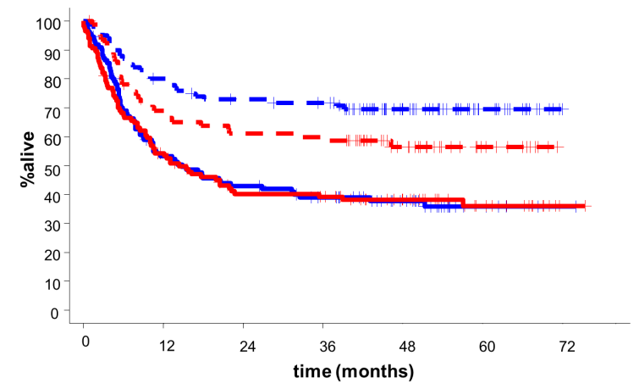
Is more precise therapy clinical relevant?
RATIFY: Overall Survival Post-Transplant
Treatment With MIDO Increases OS After SCT in CR1
SCT in CR1
HR 0.61
SCT outside CR1
HR 0.98
Midostaurin
Placebo
+ Censor
Stone RM, et al. N Engl J Med 2017; 377: 454-464.

Slide 26
NGS for MRD

Slide 27
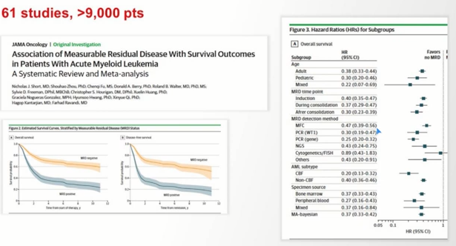
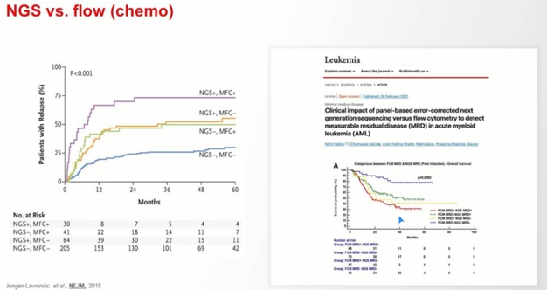
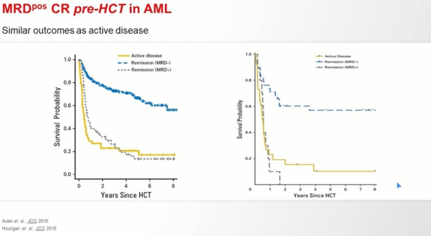
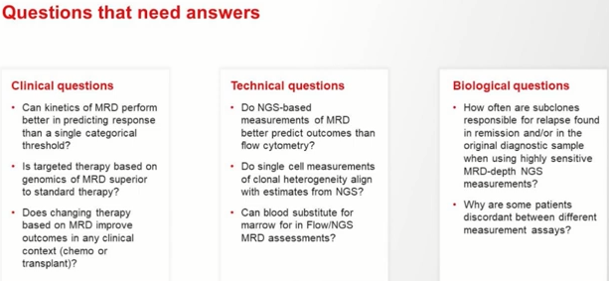
For MRD (MRD =Active disease)

Slide 28
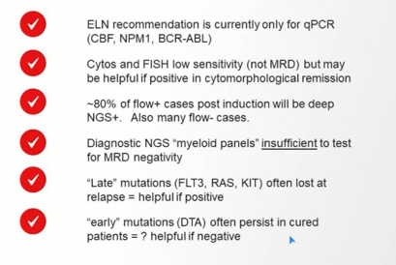
NSG for MRD

Slide 29
NGS for patient specific, clinically relevant analysis

Slide 30
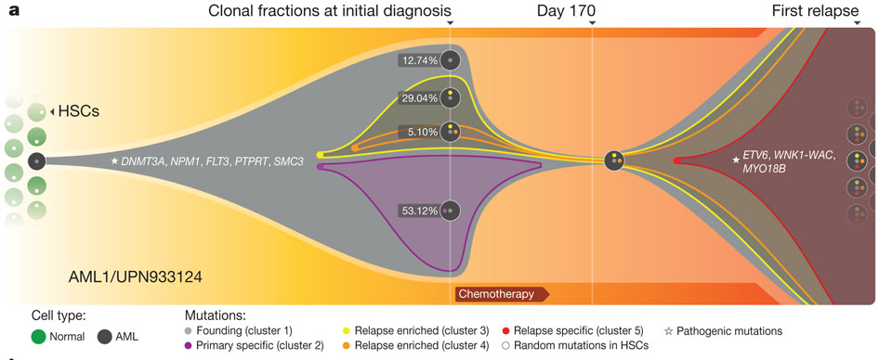
The complex chronology & architecture of AML: expansion of pre-leukemic mutations (from CHIP to pre-leukemia), founding & subclonal mutations (AML onset), persisting (clonal remission) & emerging (relapse)
L Ding et al. Nature 2011

Slide 31
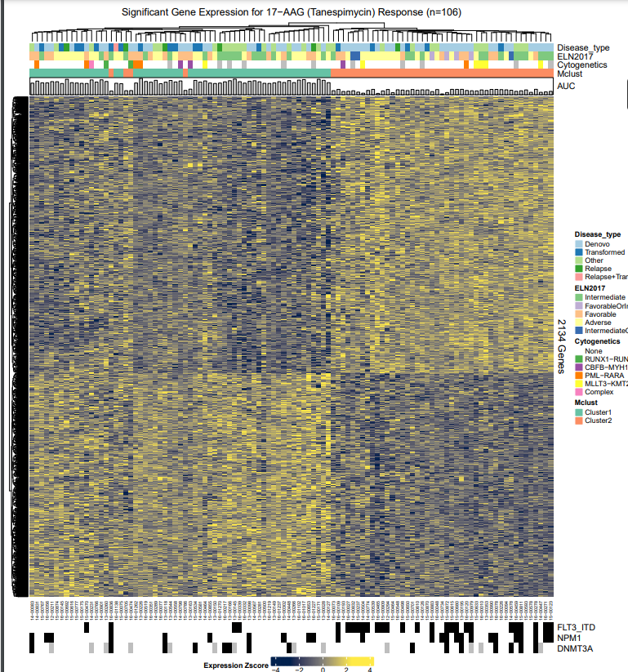
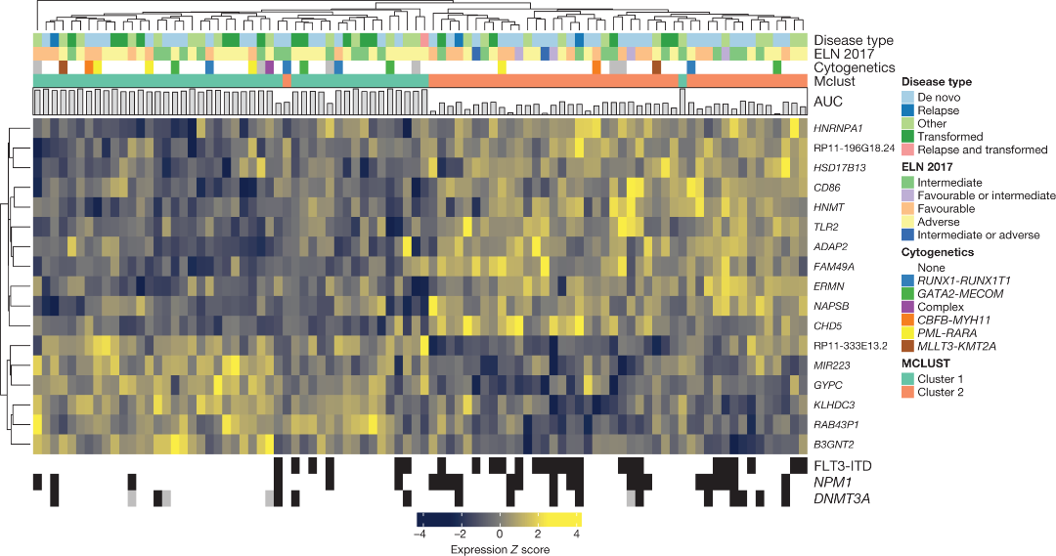
Functional genomic landscape of AML (Beat AML): correlation of mutational events/gene mutation interaction/gene expression profile with drug sensitivity “in vitro”
Notes:
And what happens at a molecular level? As you well know/you know very well this picture, AML is a very heterogeneous genetic disease and in the last years the mutational landscape of AML has expanded a lot, with new recurrent mutations , and that has led us to change our system to analyze them in the lab.

Slide 32
NGS in mapping the molecular landscape of AML
(research)

Slide 33
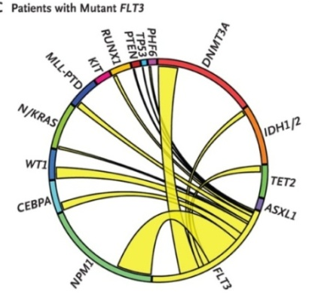

European Public-Private Partnership for Big Data in Hematology.

Slide 34
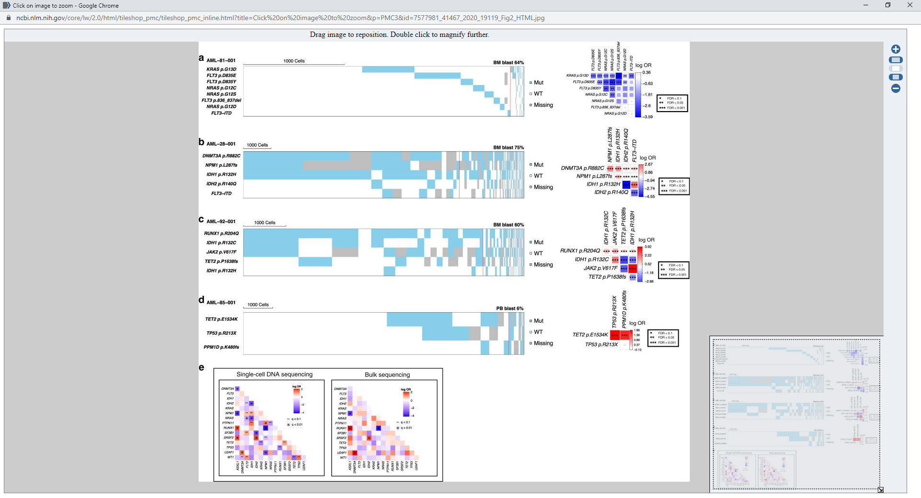
Patterns of mutual exclusivity of driver mutations revealed at single-cell level (vs. bulk profiling)
Signalling mutations
IDH1 & IDH2 mutation
TP53 & PPMD1D
Kiyomi Morita, et al. Nature Comm 2020; 11: 5327.

Slide 35
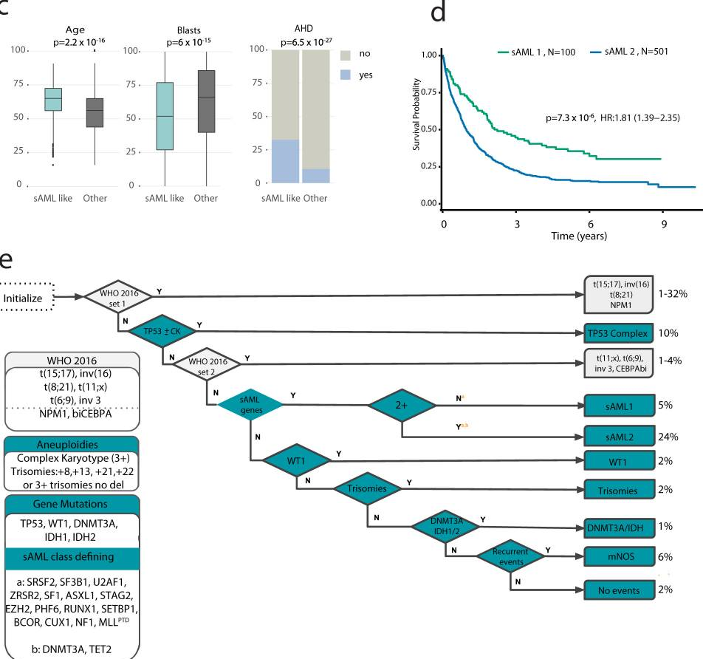
An unified classification and risk-stratification in AML: identification of a large MDS-like or secondary AML like category
Yanis Tazi, et al. Nat Commun 2022;13:4622
Performed in 3653 informative pts. (UK-NCRI & AMLSG)

Slide 36
Conclusions
NGS is revolutionizing pathology and laboratory medicine
• Allows for true personalized medicine
• Facilitates use of targeted therapeutic strategies
• Costs are rapidly decreasing while the technology continues to improve
• Challenges remain
– Cost and reimbursement
– Data analysis
– Variant interpretation
• Today – panels and genetically complex single gene analysis; detection of targeted structural variants
• Future – routine comprehensive whole genome analysis

Slide 37
Do we need a comprehensive genetic characterization with Targeted NGS for all pts with AML?
Yes in patients with “intent to cure”
NSG translates into clinical valuable information
Identification of germline predisposition mutations
for (accurate) diagnosis
For stratification (improved prognostic assignment)
For (more precise) therapy (Identification of druggable targets)
For therapy evaluation (MRD monitoring)
Hints to track clonal evolution, (More rationale choice of therapy at relapse)
For research (understanding high genetic heterogeneity, Inter-individual, Intraclonal)

Slide 38


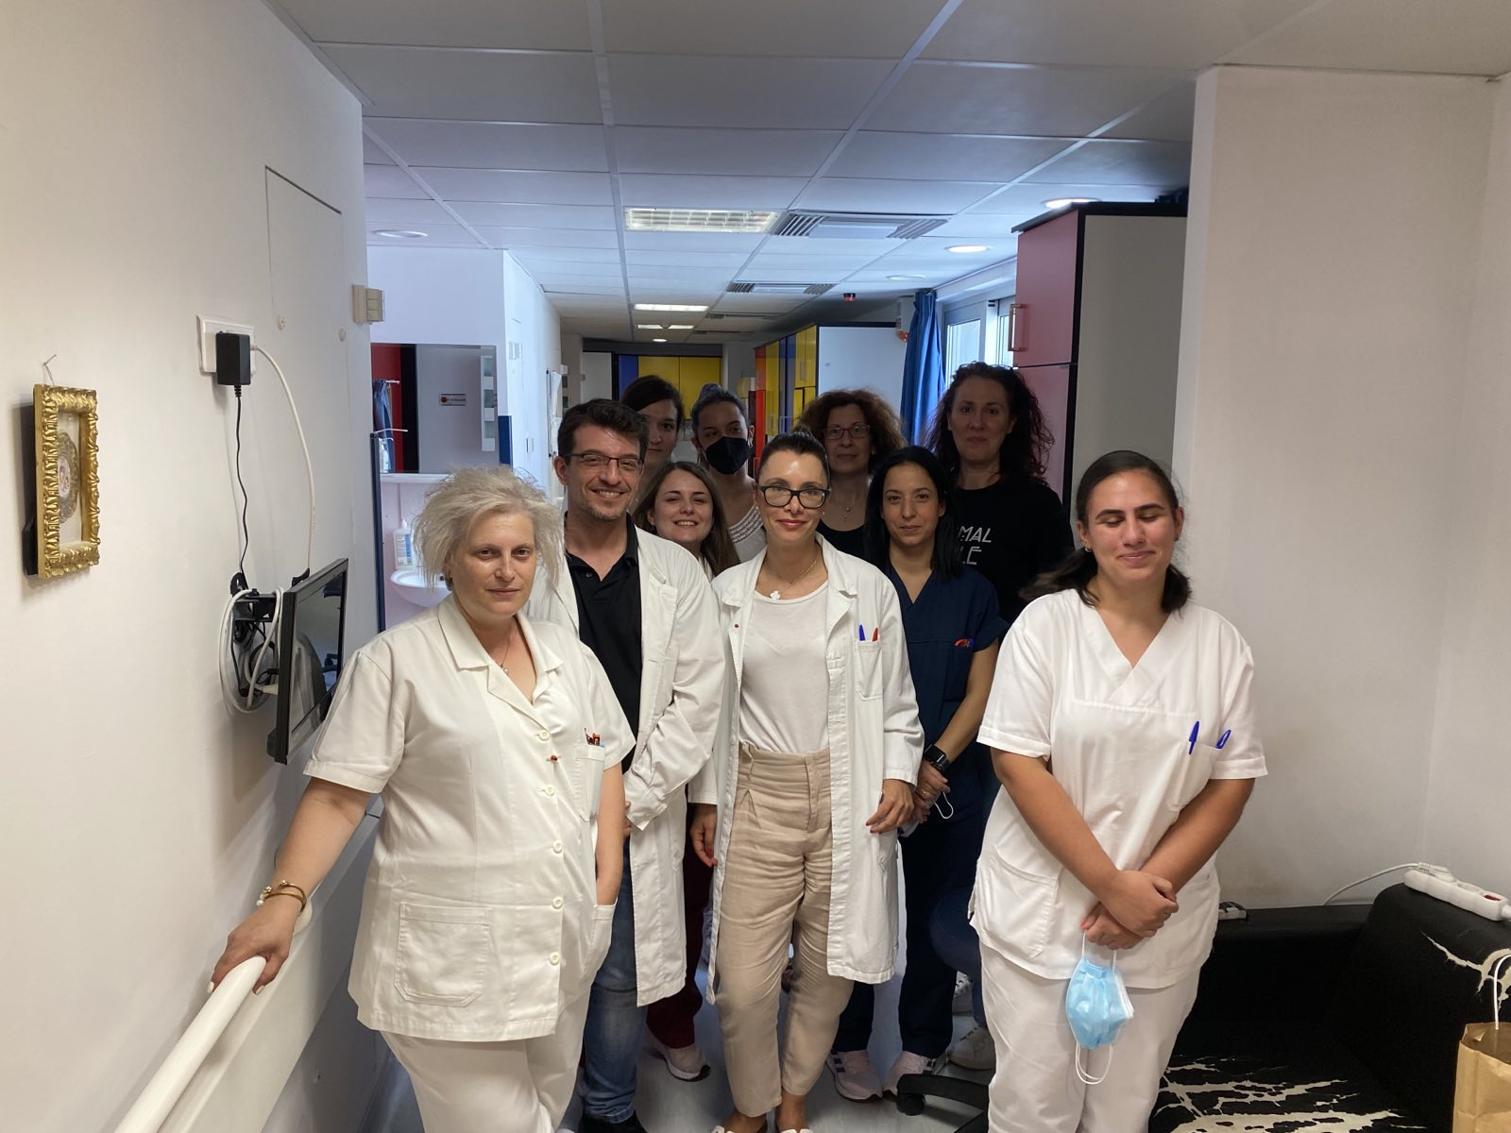
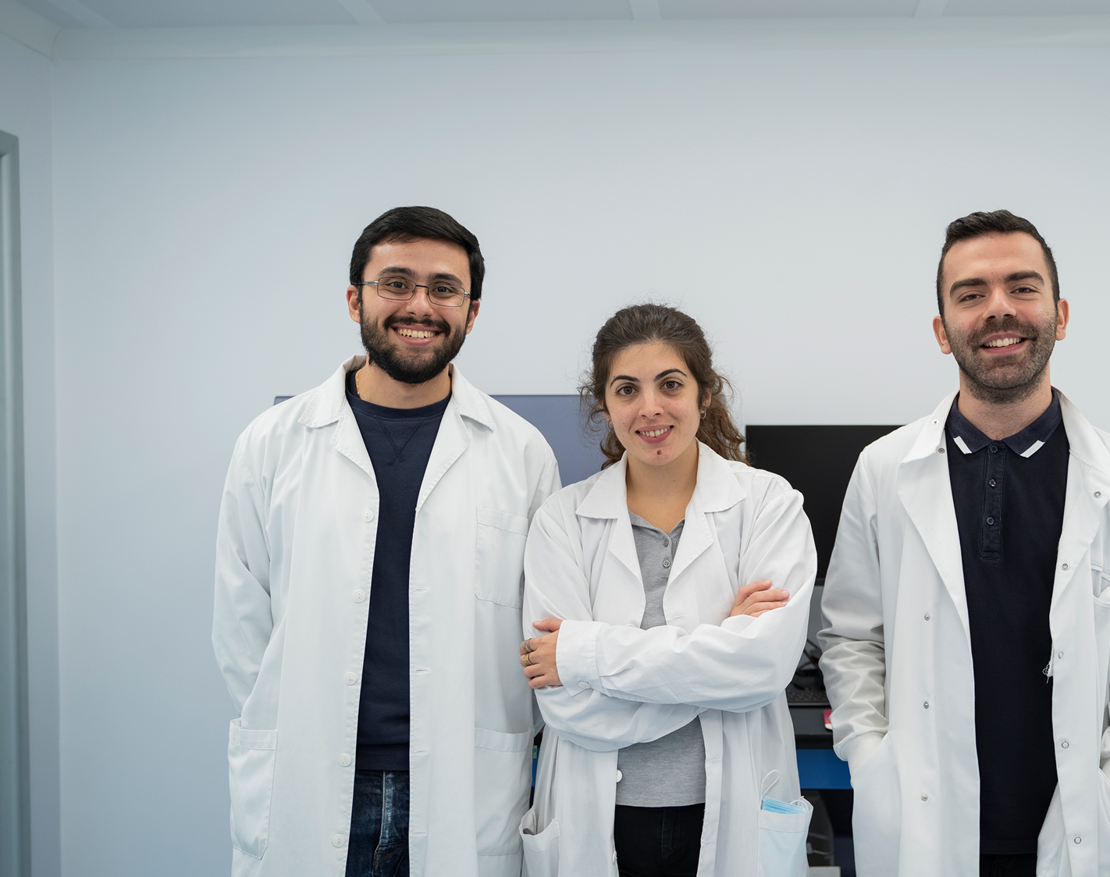






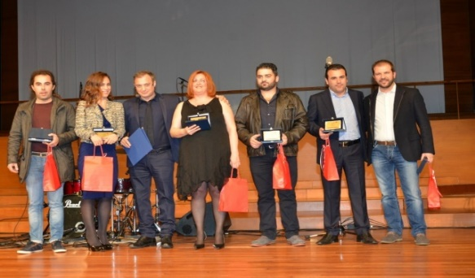


Cell Therapy Program
University of Patras
The People
FUNDING / SUPPORTERS
DONORS

